Slide 1
Placement Management system
By Praveena
Under the guidance of Anjana Sarode

Slide 2
Introduction
The project named “Placement Management System” , student/company information is a web based system
The Placement Management System is developed as an attempt to take a record of company and students by restricting such a large database to that of a particular class of students or company
The system provides the facility of viewing both the personal and academic information of students and company

Slide 3
Technology
HTML
JAVA

Slide 4
Objective
Our project has a big scope to do
We can store information of all the students
Students can maintain their information and can update it

Slide 5
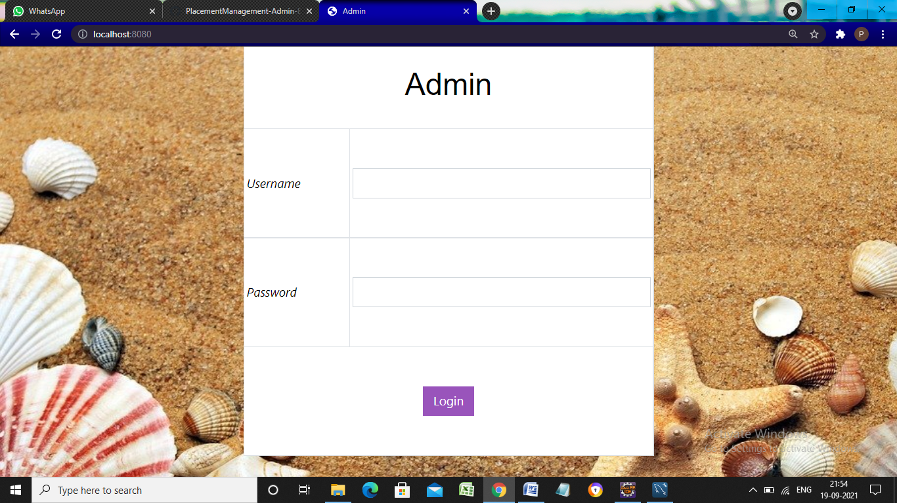
Login page:

Slide 6

Enter username ,password which you stored in MySQL database.

Slide 7

Enter login, it redirects to home page.

Slide 8
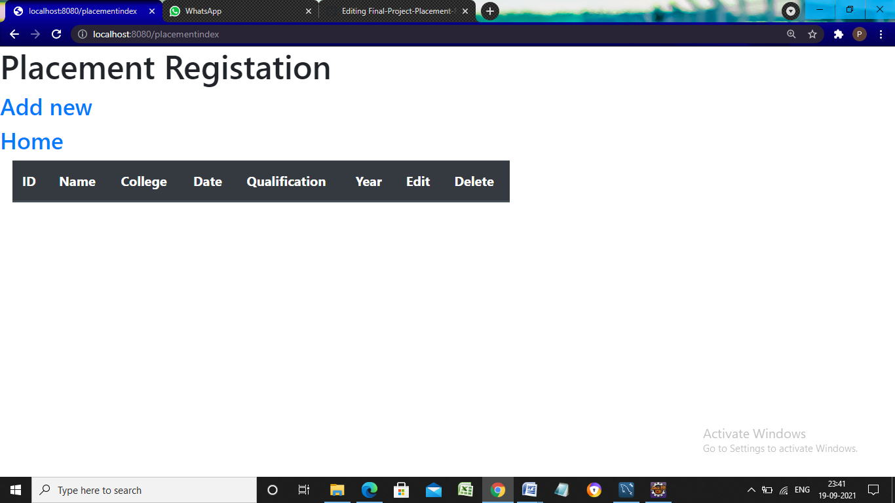

Slide 9
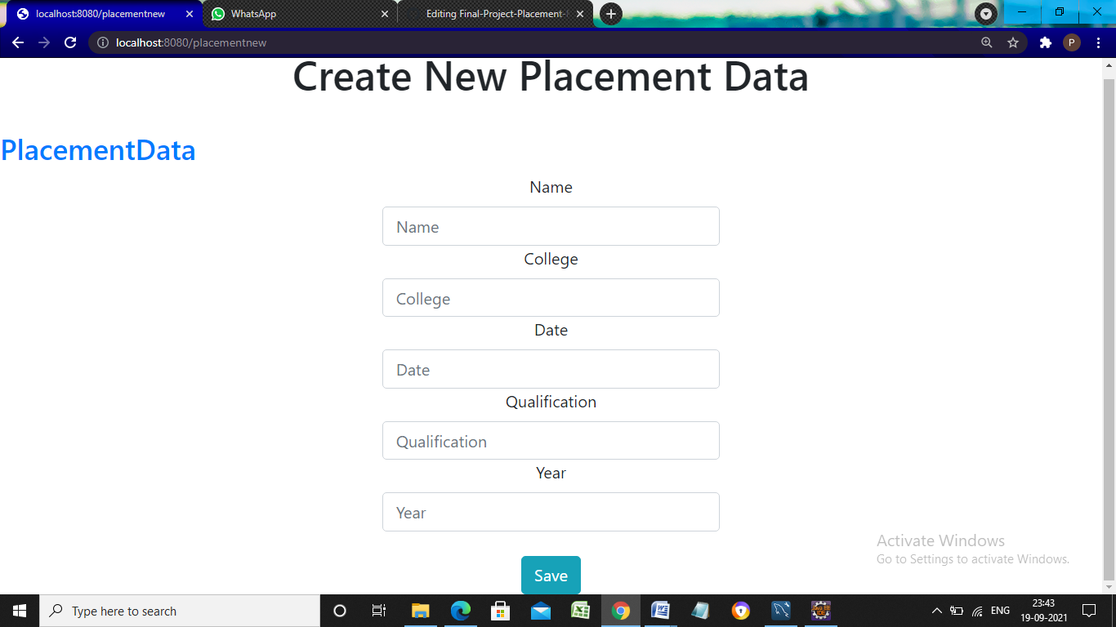

Slide 10
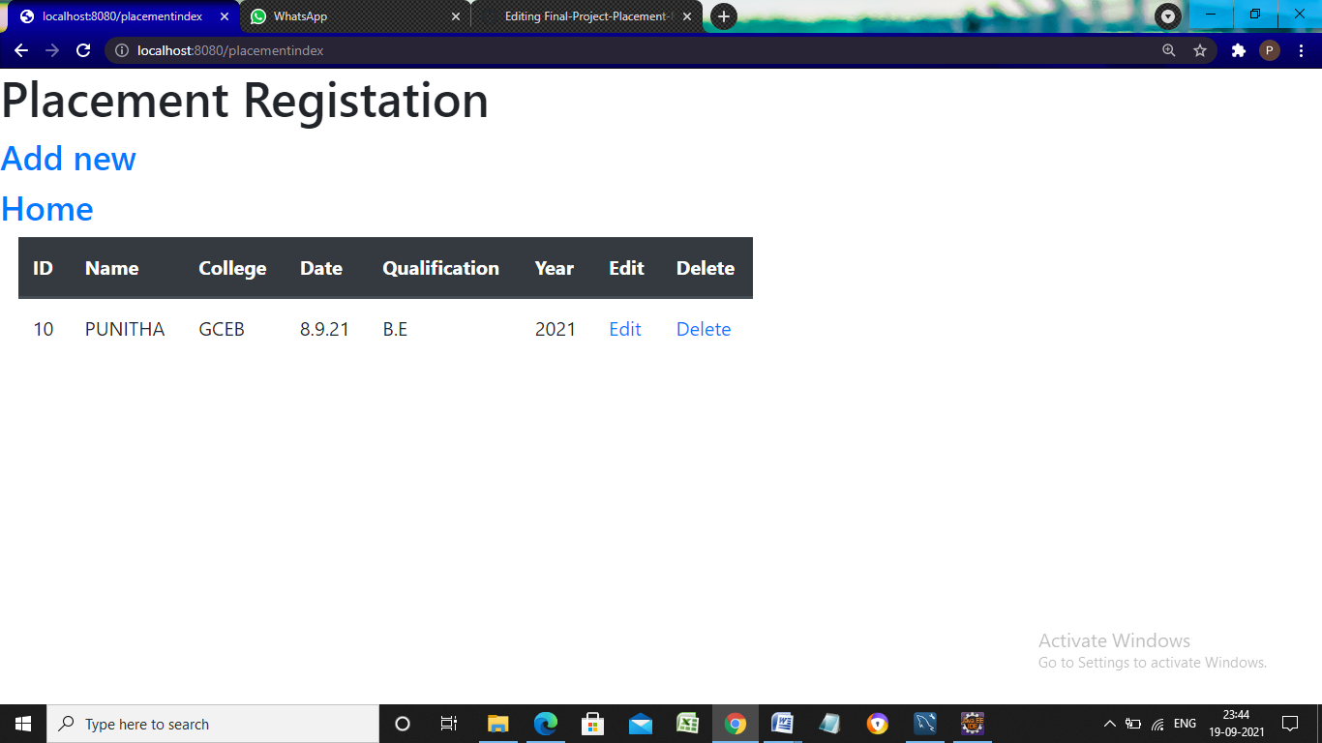
Click home it redirects to home page .click open on college details .

Slide 11
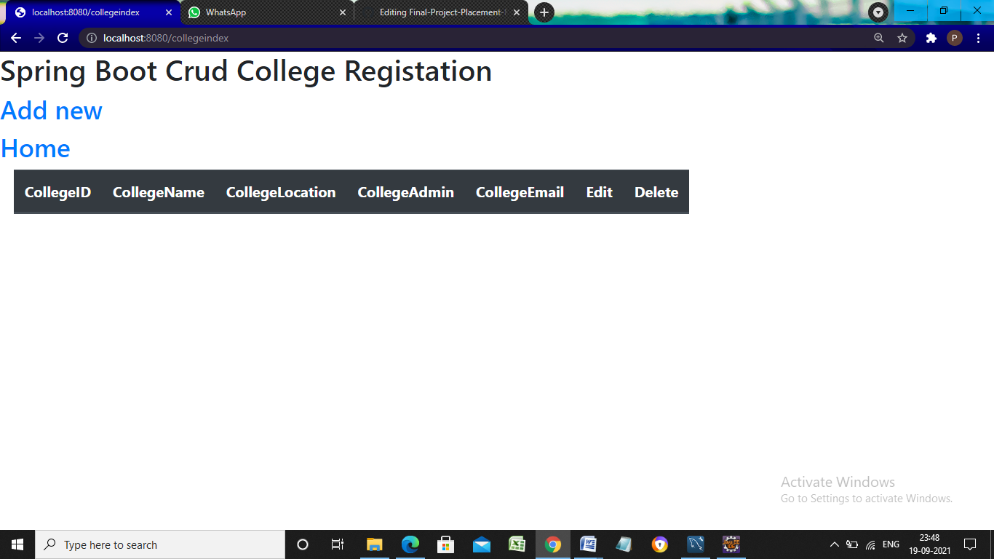

Slide 12
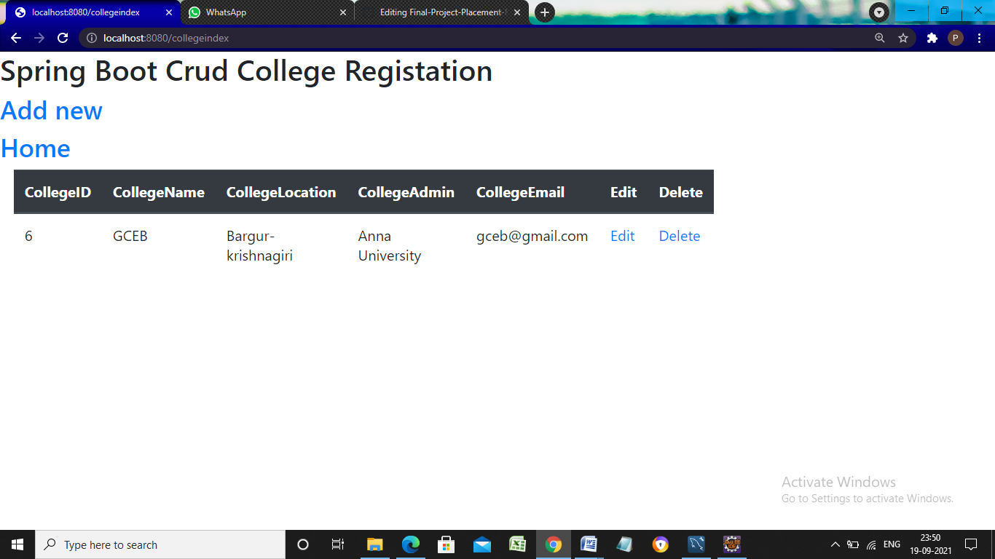

Slide 13
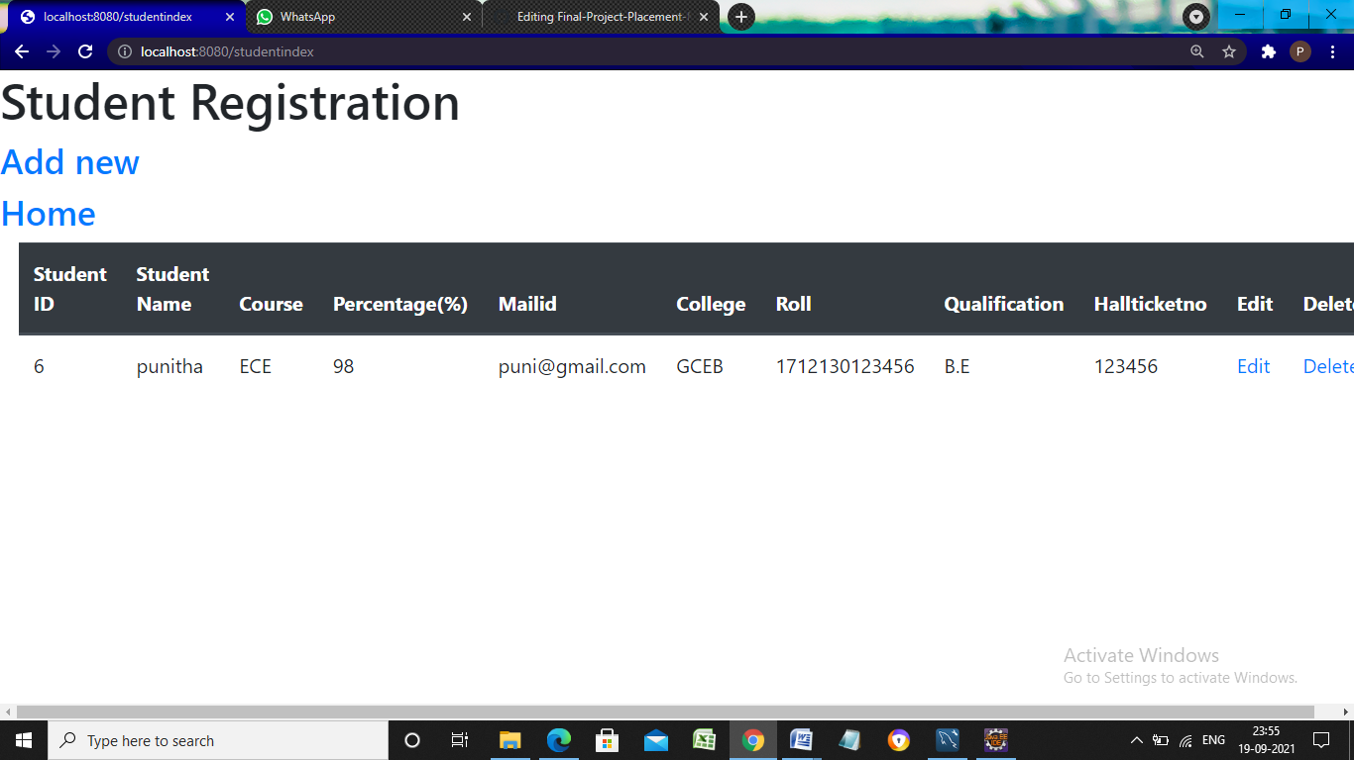

Slide 14
Thank you

